Slide 1
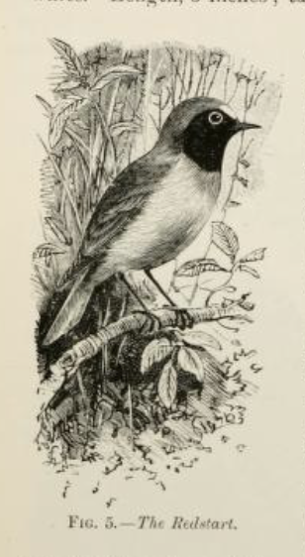
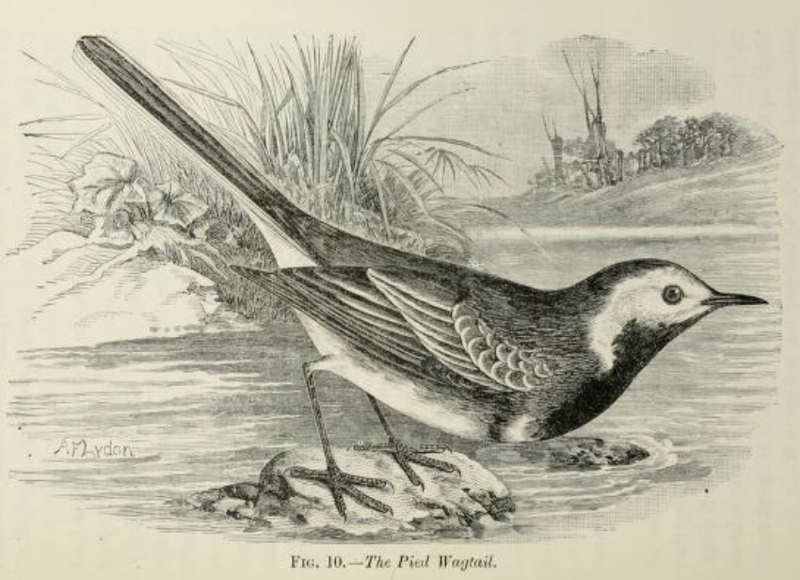

Dreambirds in Motion: AI-driven Surreal Video Generation with Pose-Guided Temporal Consistency
Xinyu(Marceline) Cheng
GitHub username: esemsc-xc924

Slide 2
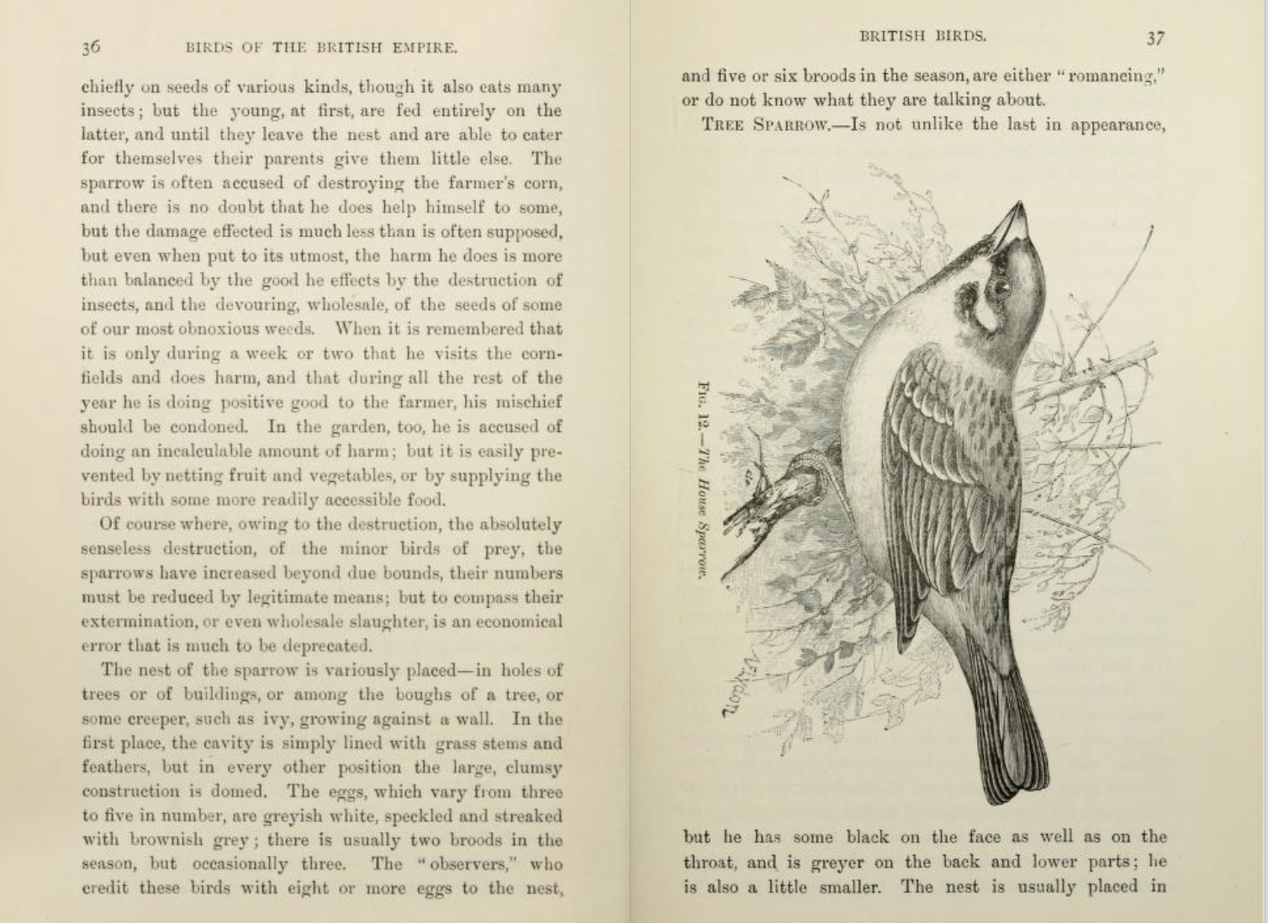
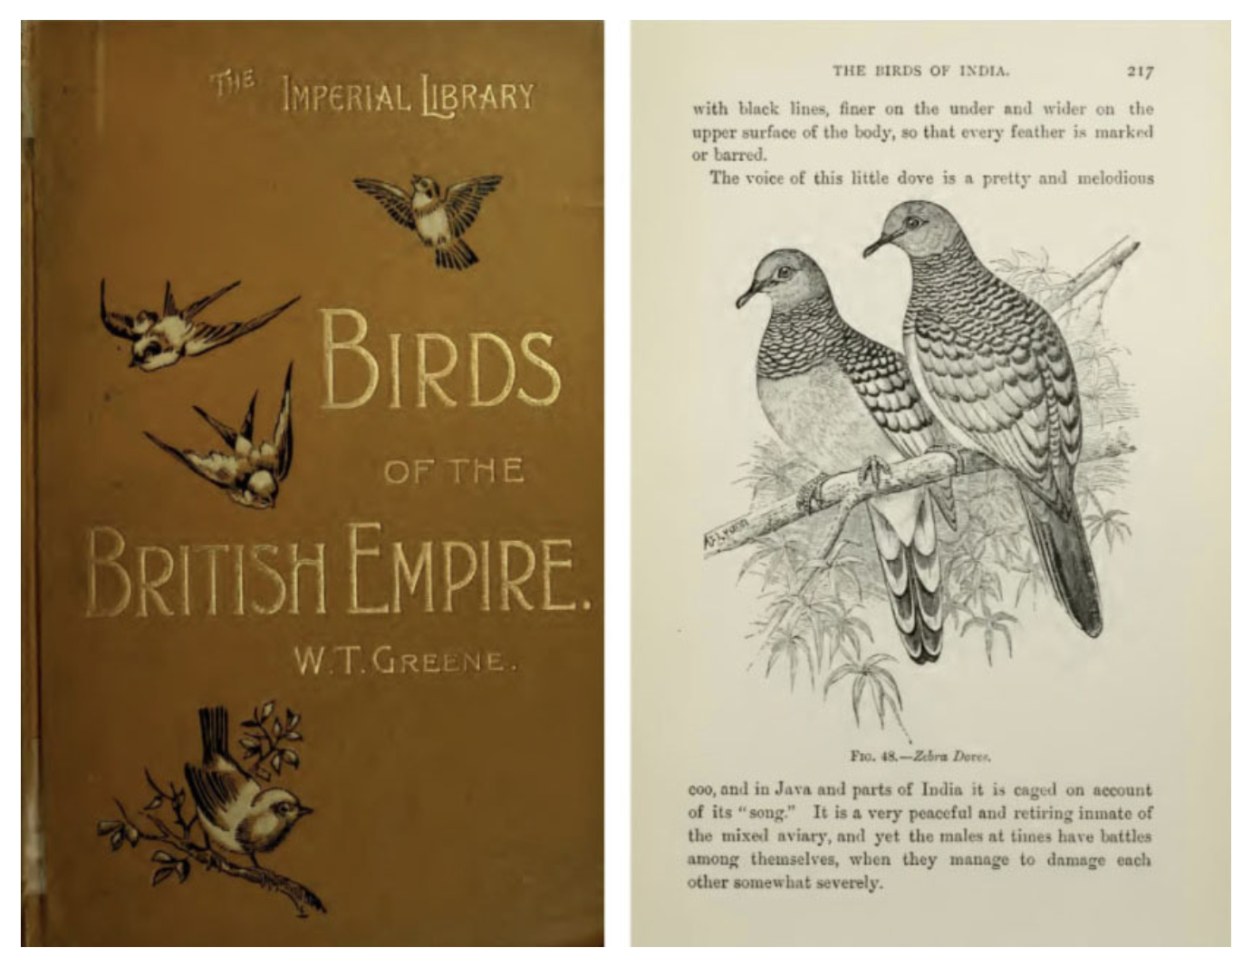
Background & Motivation
Bird videos are important for animation, education, creative media.
Challenge: Lack of temporally annotated skeleton data for birds.
Existing generative models:
Image-to-video → unstable wings, flickering, loss of style.
Skeleton priors (OpenPose) → designed for humans, poor transfer to birds.
Gap: Need domain-specific skeletons & temporally coherent video generation.

Slide 3
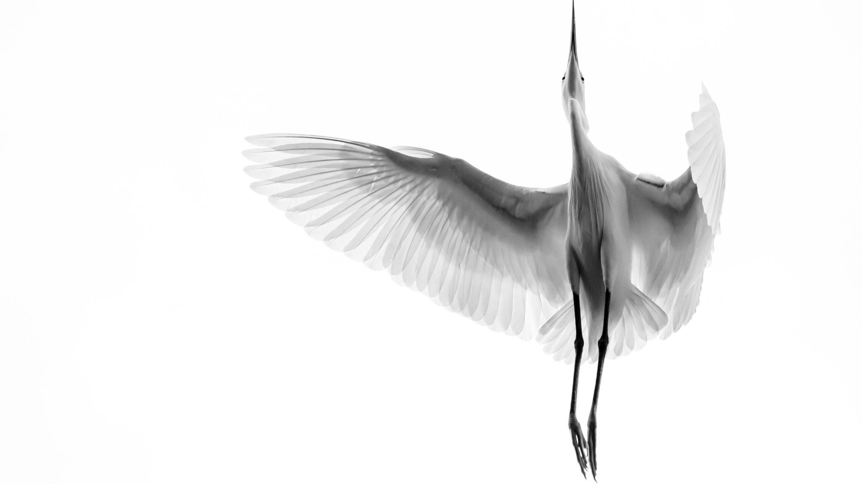

Objective
Build a skeleton-driven framework for surreal bird motion video generation.
1. Reliably detect bird keypoints.
2. Generate realistic & flexible motion sequences.
3. Render skeleton-guided videos while preserving surreal traits.

Slide 4
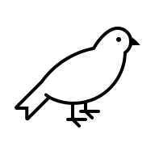
Models Overview
HRNet: Keypoint detection
High-resolution CNN, accurate keypoint localisation.
Motion Diffusion Model: Motion Generation
Diffusion + Transformers for smooth, diverse motion sequences.
AnimateDiff + ControlNets: Skeleton-guided Rendering
Video rendering with structural conditions:
Pose Edge Depth
Together: controllable, temporally consistent, stylistically flexible.
HRNet
MDM
AnimateDiff

Slide 5
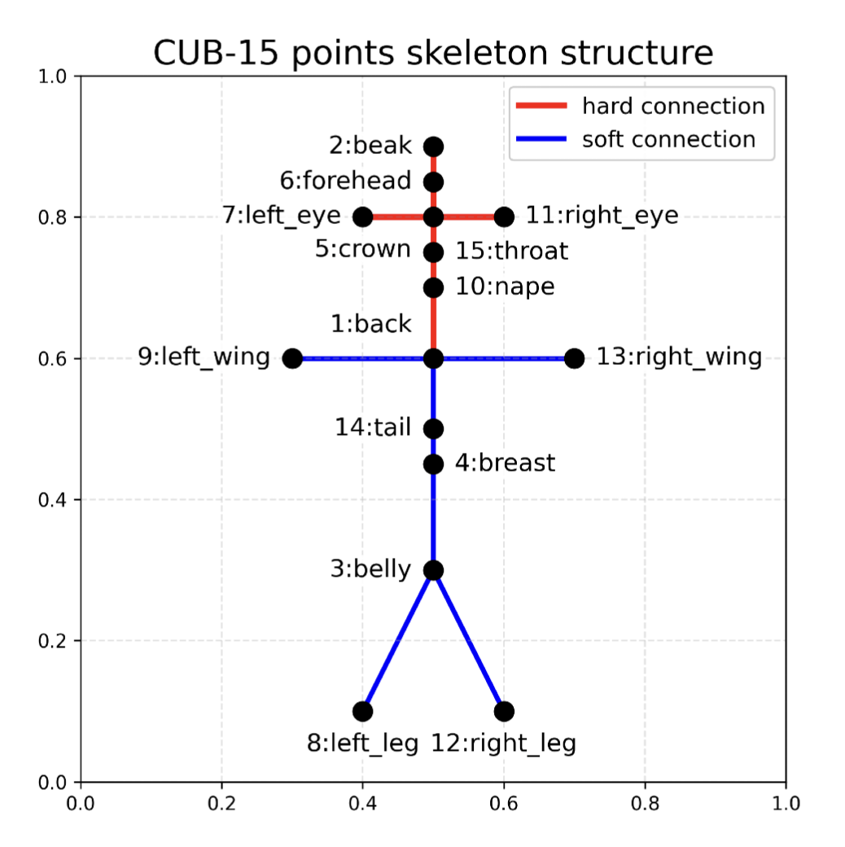
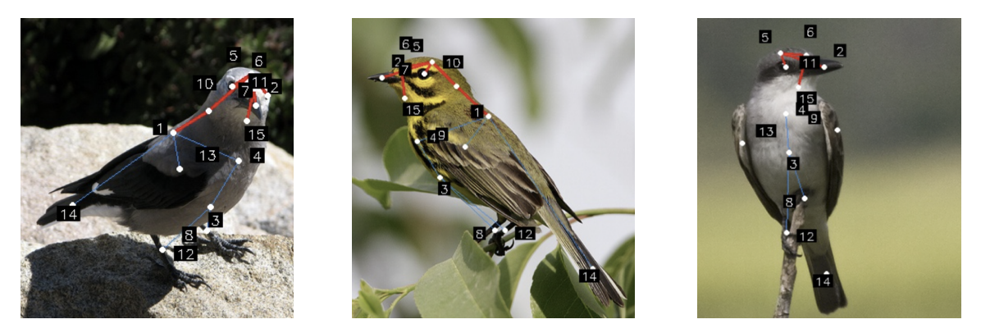
Dataset - 1
CUB-200-2011 → CUB-15 skeleton
200 species, 11,788 images, 15 landmarks.
Converted to custom CUB-15 skeleton graph for HRNet training.
Hard connections (red)
rigid parts (beak–crown–spine);
Soft connections (blue)
flexible appendages (wings, legs, tail)

Slide 6
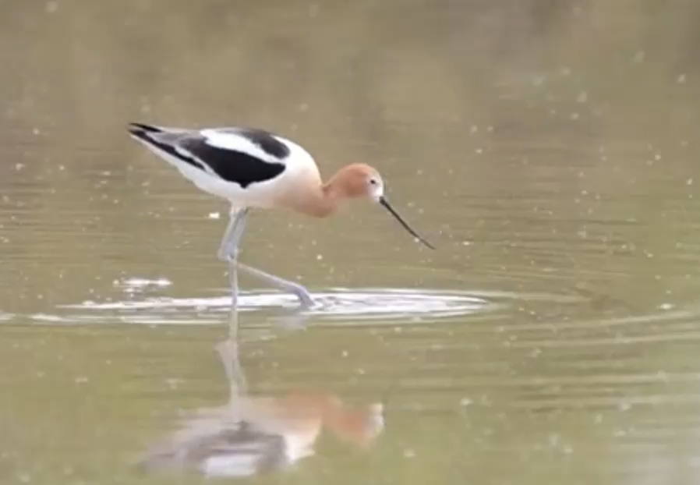
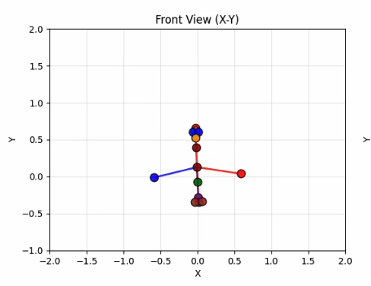
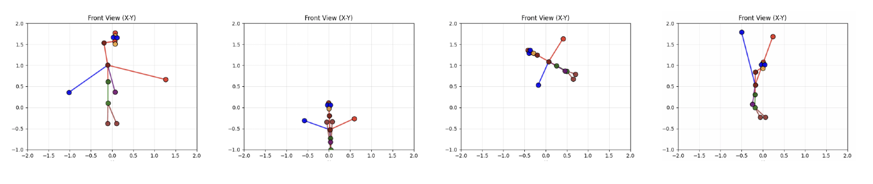
Dataset - 2
SynCUB15 Motion Dataset
4,000+ synthetic sequences, each 64 frames × 15 keypoints.
6 canonical actions: takeoff, gliding, hovering, soaring, diving, landing.
With biomechanical constraints to ensure realism.
VB100 flight videos used as reference to validate motion plausibility and inform action taxonomy.

Slide 7
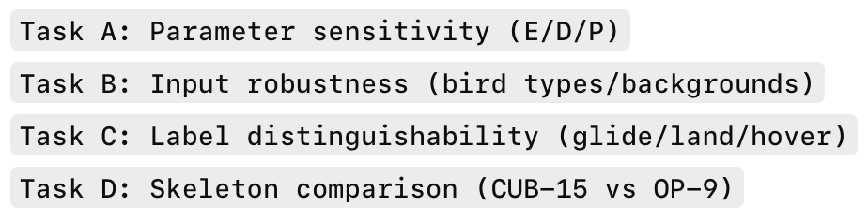
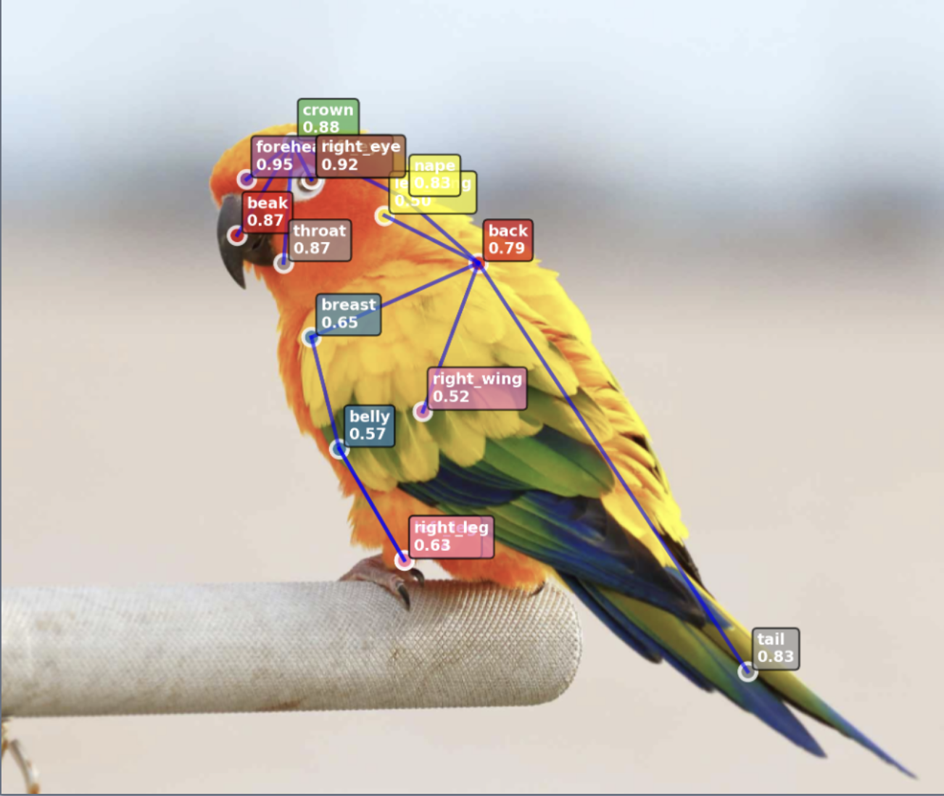
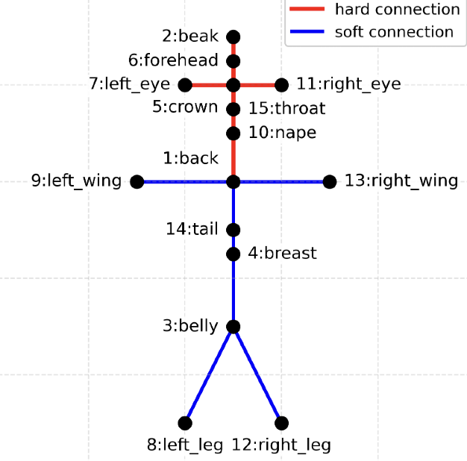
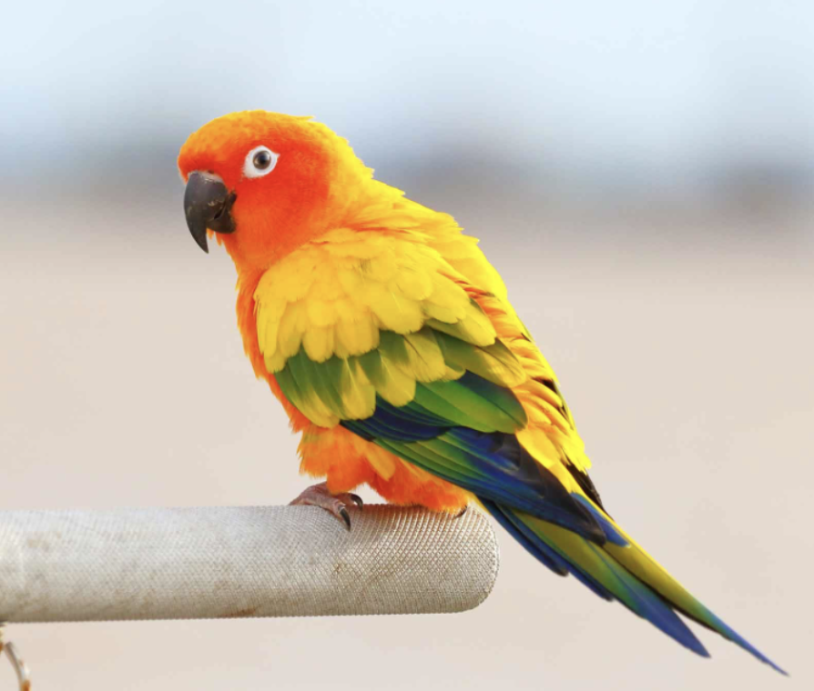
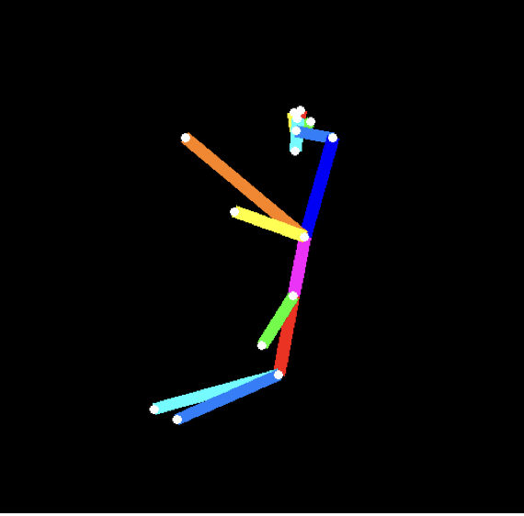
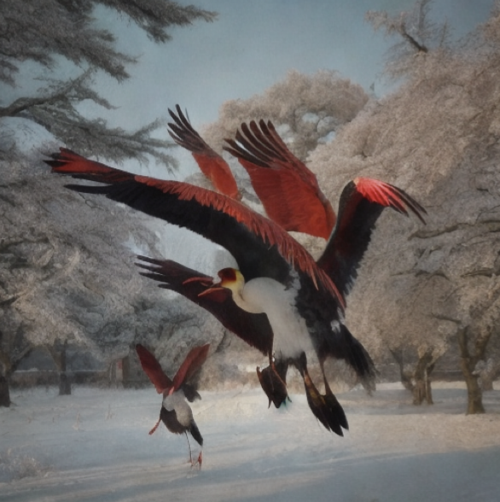
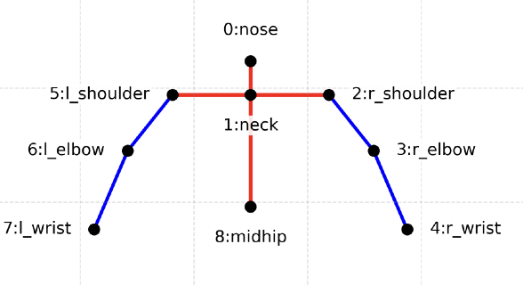
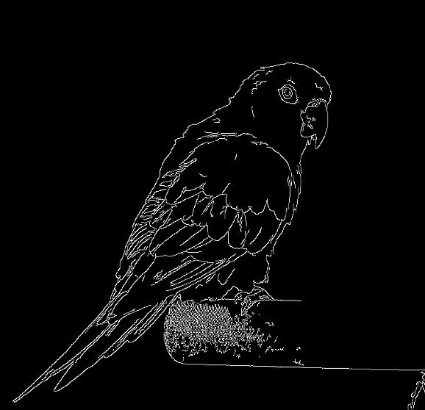
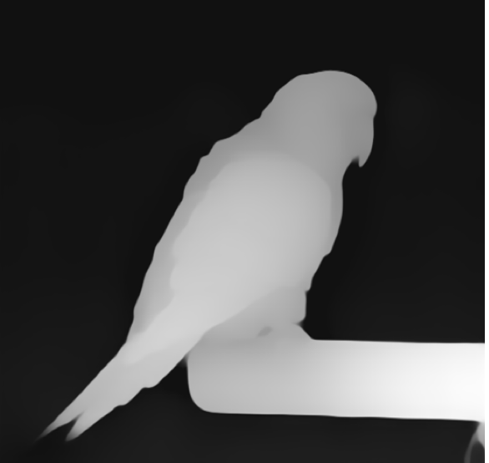
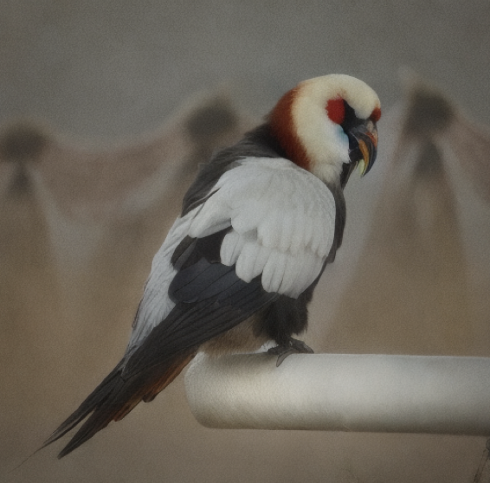
Pipeline Workflow
Phase 1:
Pose Detection
Phase 2:
Motion Generation
Phase 3:
Video Rendering
CUB-200 DataSet
11,788 images, 200 classes
VB100 &
Bird motion Study
MOS Evaluation
Web User Interface
Skeleton representation
Data
Pre-processing
Mathematical
Modelling
Initial Frame
15-point skeleton .npy
format [T,15,3]
Skeleton Sequences
64 Frames
15 Keypoints
CUB-15
CUB-15 Keypoints
Skeleton Dataset
SynCUB15 Bird
Skeleton Motion Dataset
>4,000 sequences, T=64, 6 labels
Input bird Image
RGB 512×512
Output Video
RGB 512×512
64 frames
Training
Training
HRNet Model
- Multi-resolution CNN branches
- Cross-branch feature fusion
- High-res features preserved
MDM Model
- Diffusion-based temporal generator
- Initial frame + action label conditioning
- Skeleton & range regularisation
Actional label
Conditions
OP-9
Pose ControlNet
Metric Evaluation
(PCK & MPJPE)
Metric Evaluation
(Train & Val Loss)
AnimateDiff Model
- Latent diffusion with temporal modules
- Extends image diffusion to video synthesis
- Multi-branch ControlNets (pose/edge/depth)
Conditioning inputs
+
64 Frames Each
Edge Detector
Edge
&
Depth ControlNet
“A red-crowned crane, cinematic lighting”
Depth Detector
Prompt Control appearance ( realistic / surreal )

Slide 8
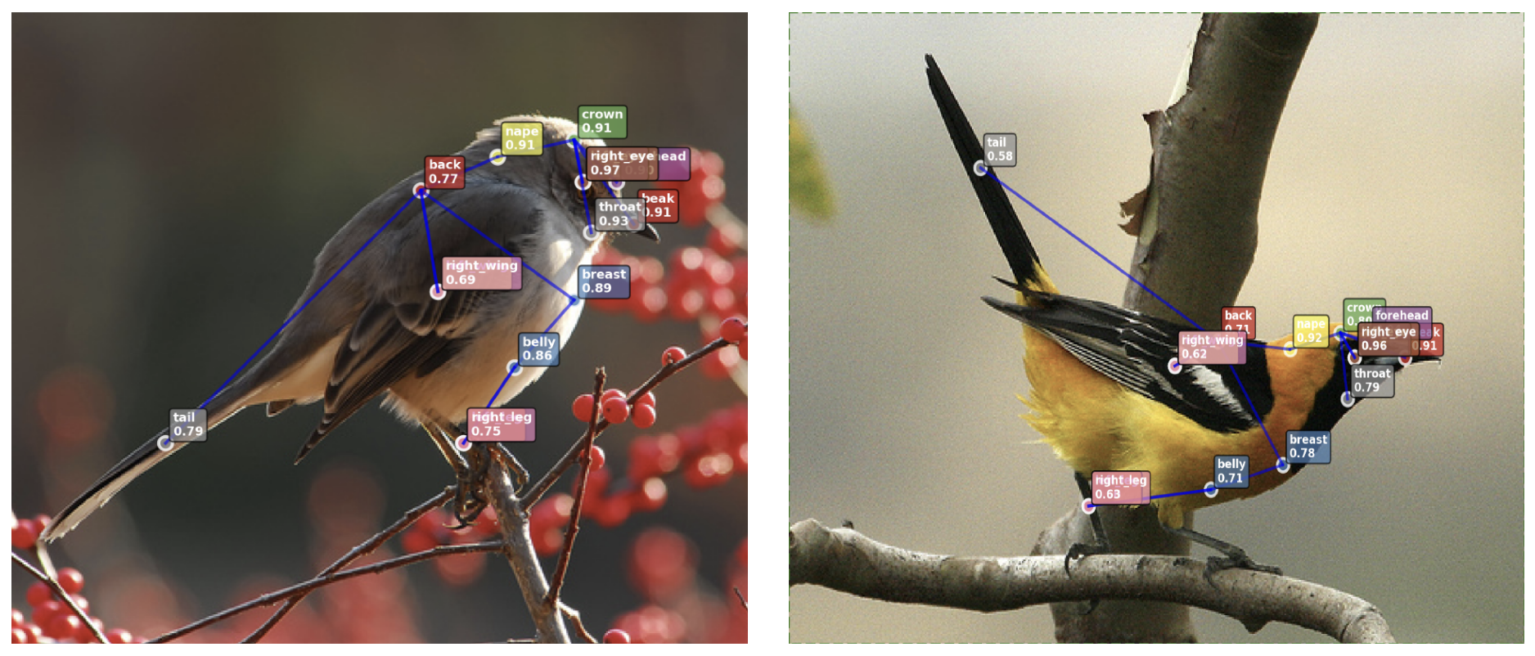
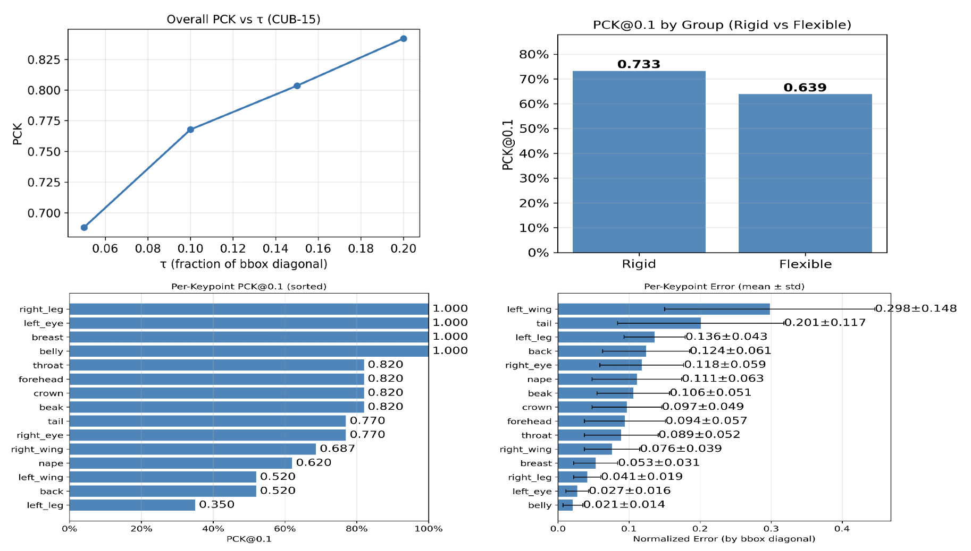
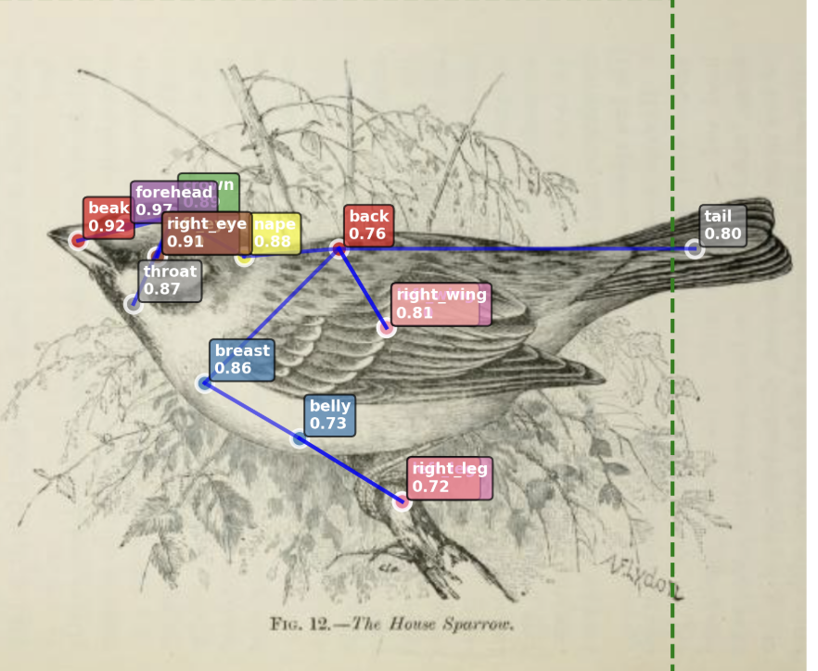
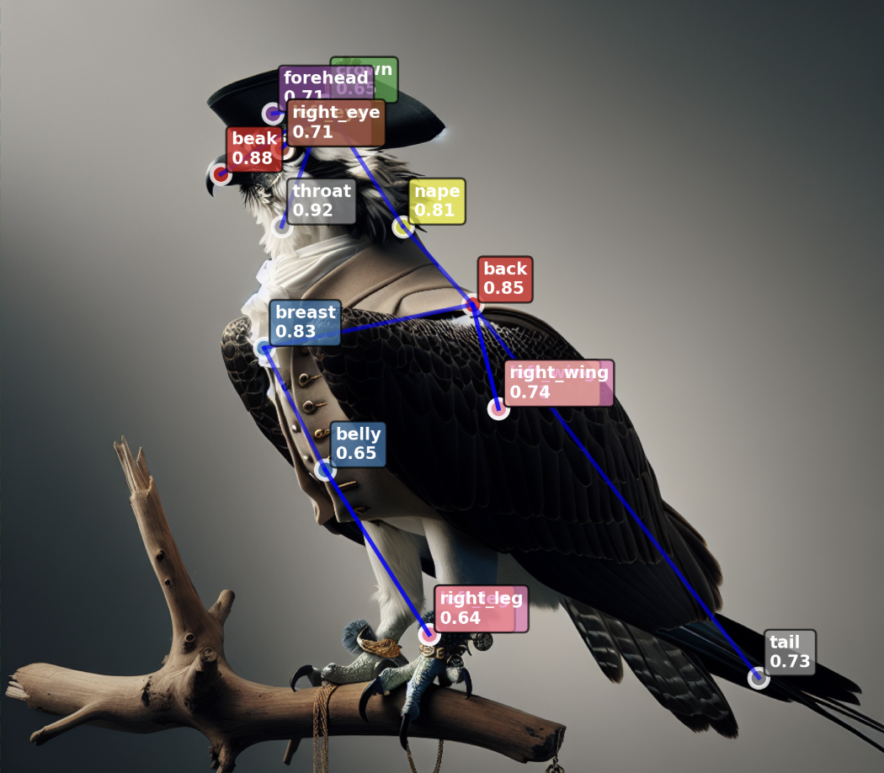
Results – Keypoints Detection
HRNet performance (CUB-15 validation):
PCK@0.1 = 0.733 (rigid 0.733 vs flexible 0.639).
Strong for rigid landmarks (legs, belly), weaker for flexible ones (wings, tail).
Insight: wings/legs hardest to localize.

Slide 9
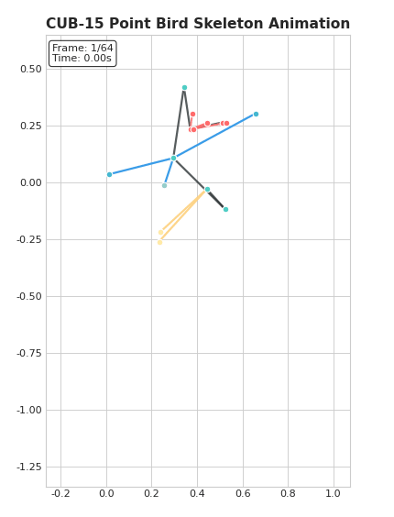
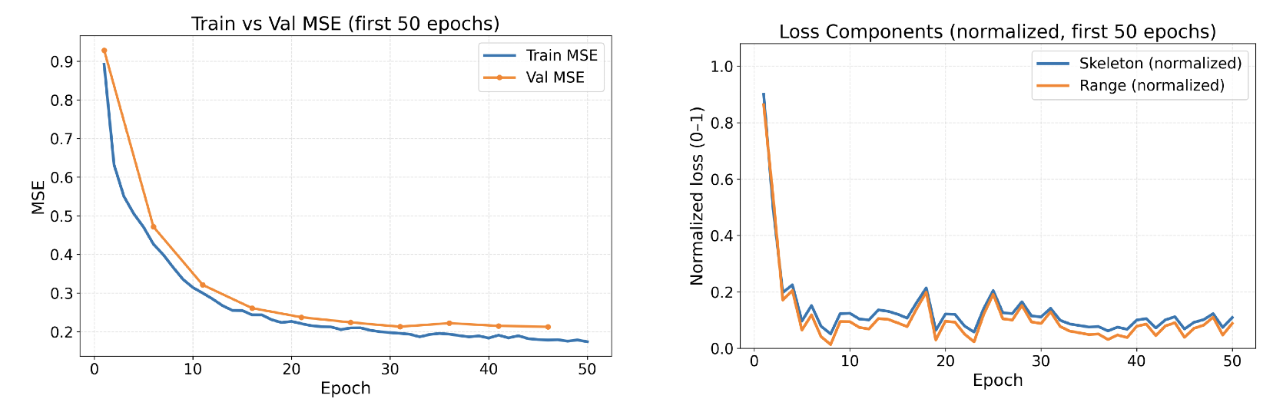
Results – Motion Generation
MDM training: steadily decreasing train/val MSE, stable skeleton & range losses.
Landing sequence sample:
Torso pitched up, wings flared symmetrically, legs extended → natural motion.
Insight: generates smooth, anatomically consistent sequences.

Slide 10
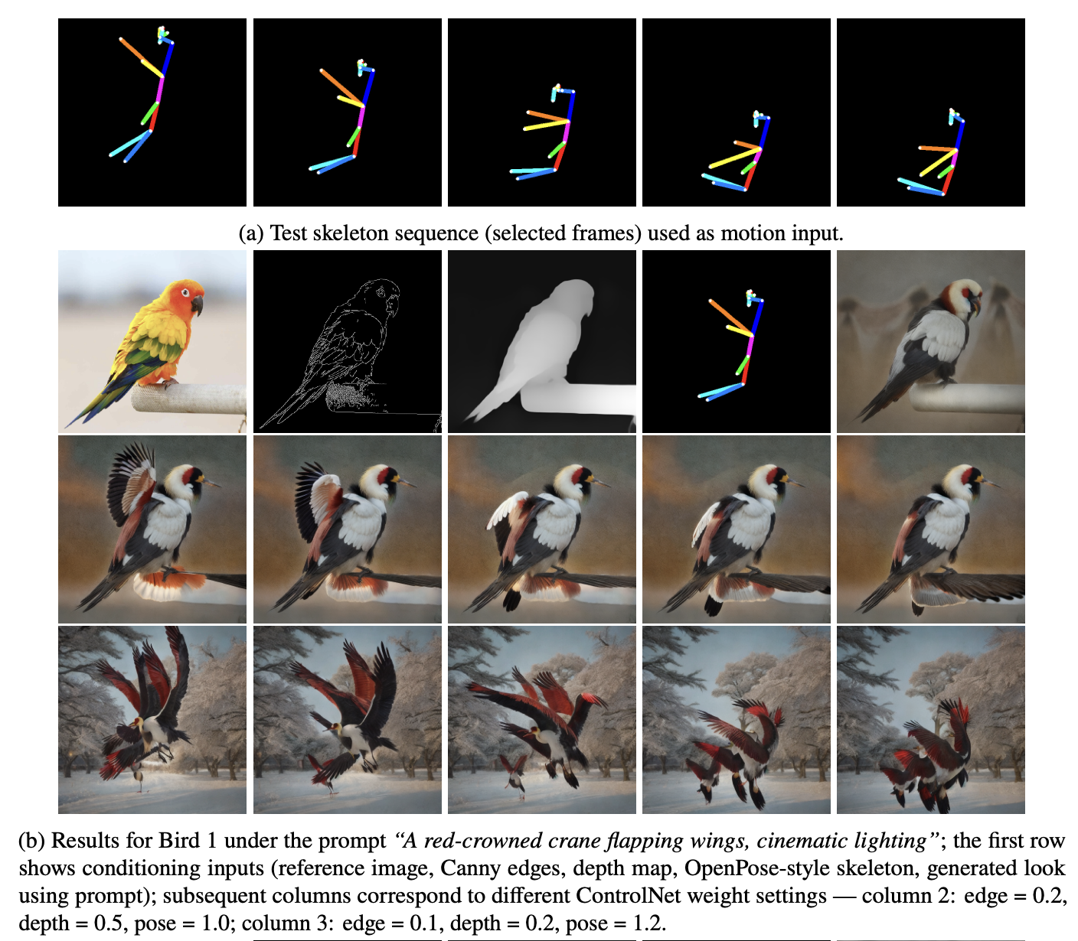
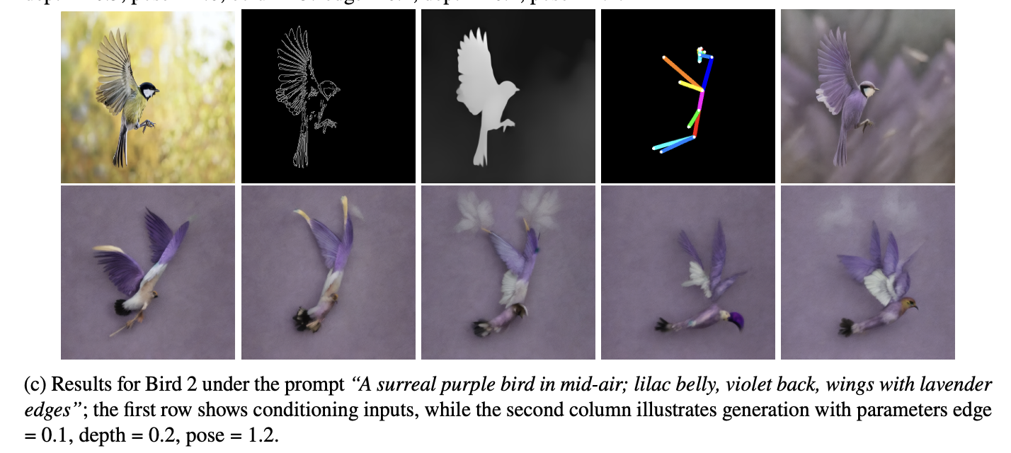
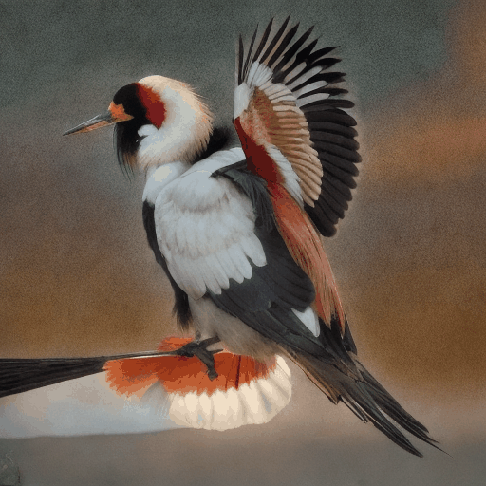
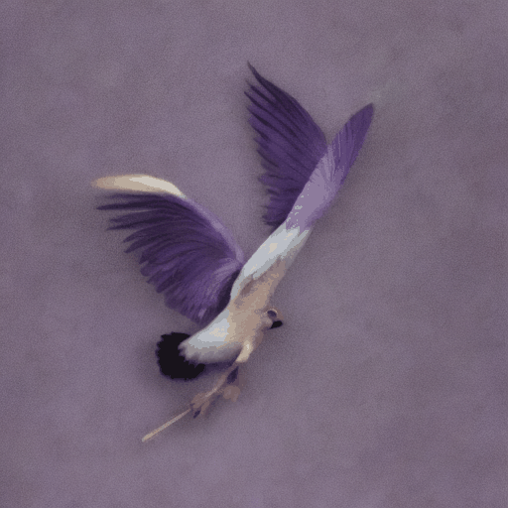
Results – Video Rendering
CUB-15 skeletons: stable wingbeats, smooth dynamics, surreal traits preserved.

Slide 11
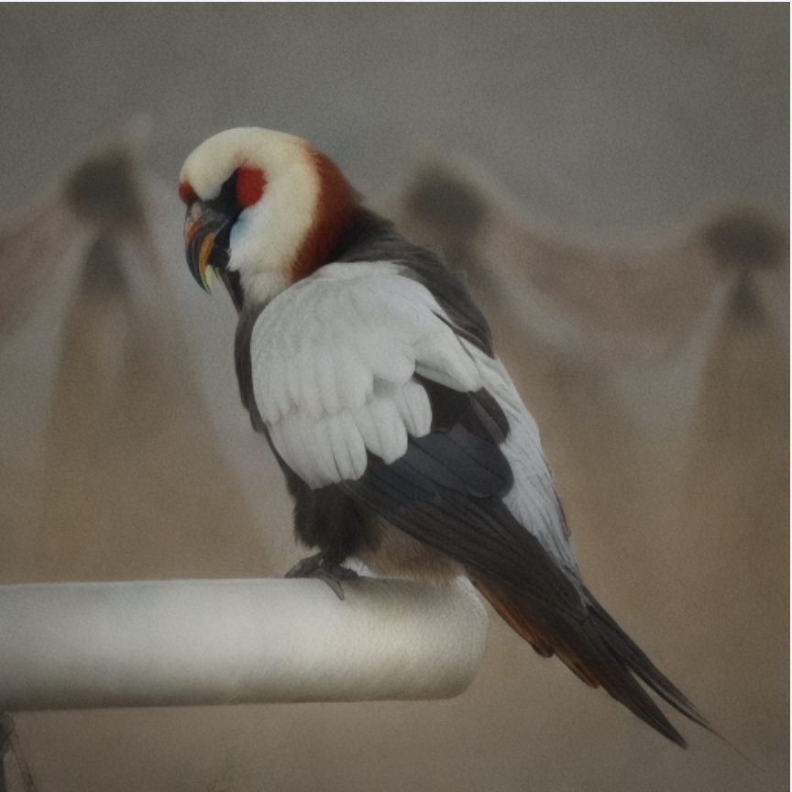
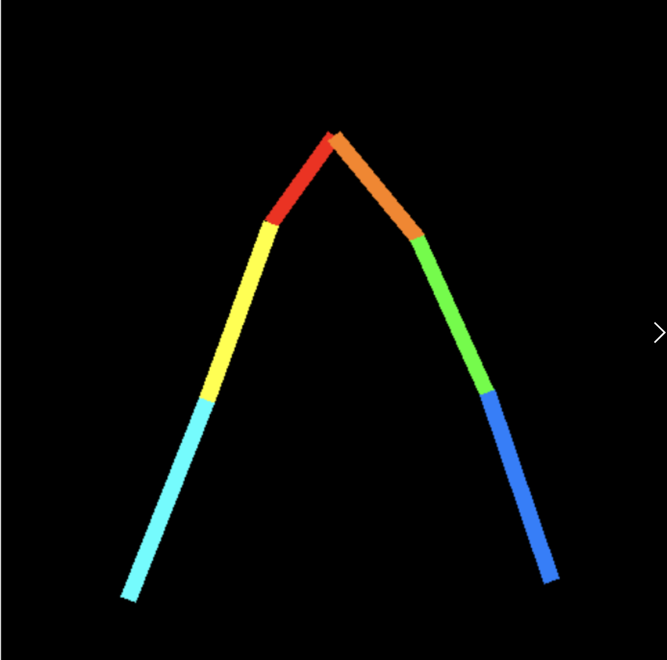
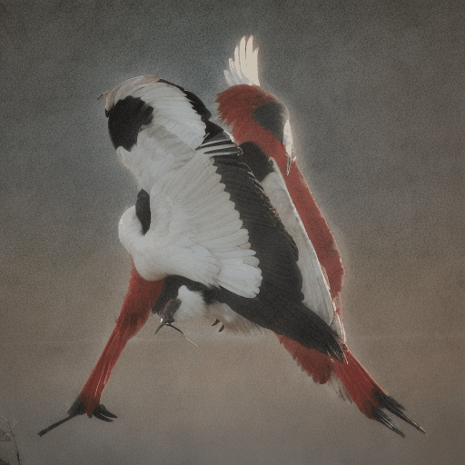
Results – Video Rendering 2
Inspiring by my early test results - with a dummy pose
perhaps because its structure resembled OpenPose-18.
+

Slide 12
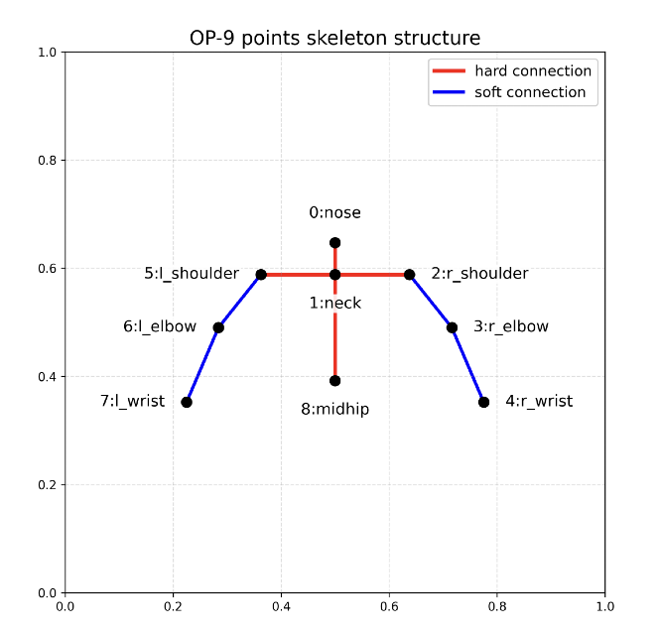
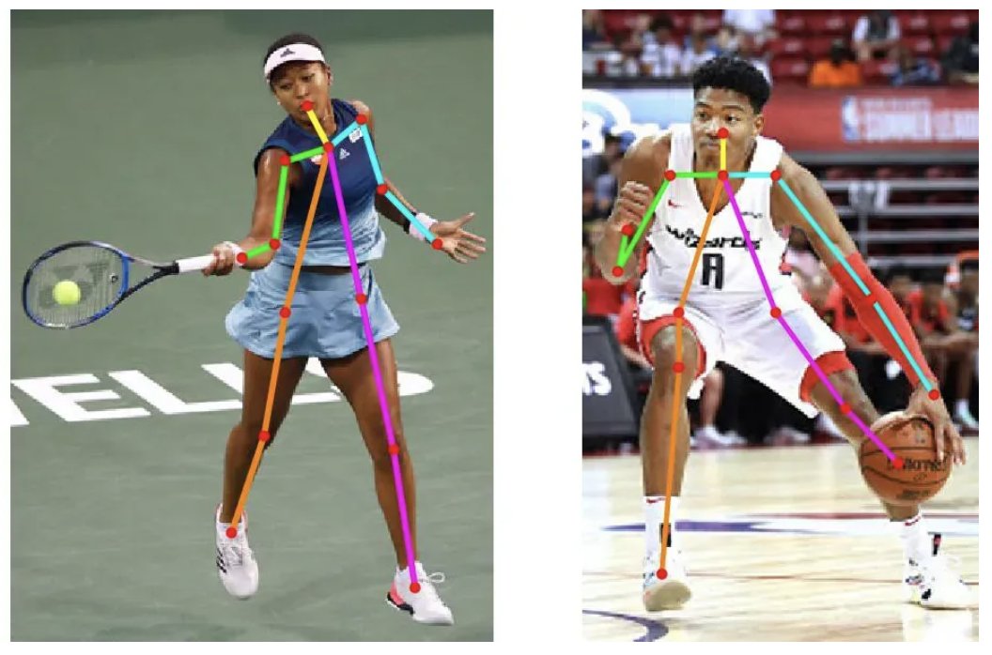
Results – Video Rendering 2
OP-9 skeletons:
more aligned with human priors but less avian-specific
Mapping logic (CUB-15 → OP-9):
crown→ Nose
Back → Mid-hip
Wing tips → Wrists
Mid-hip by inference

Slide 13
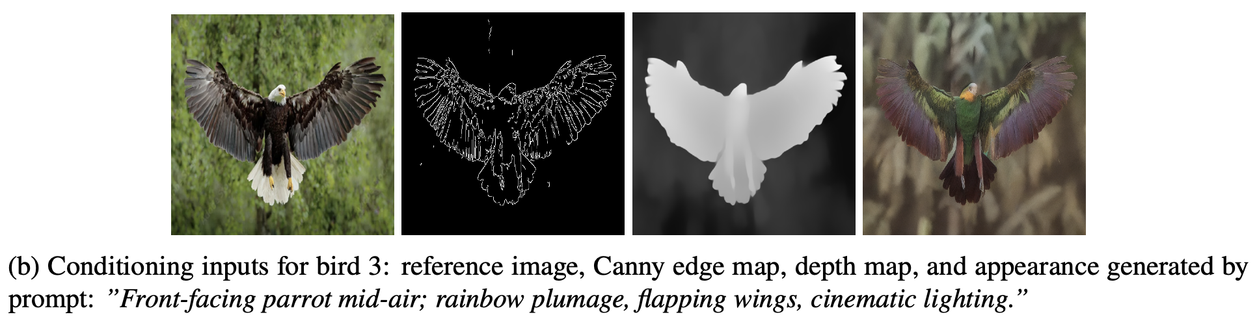
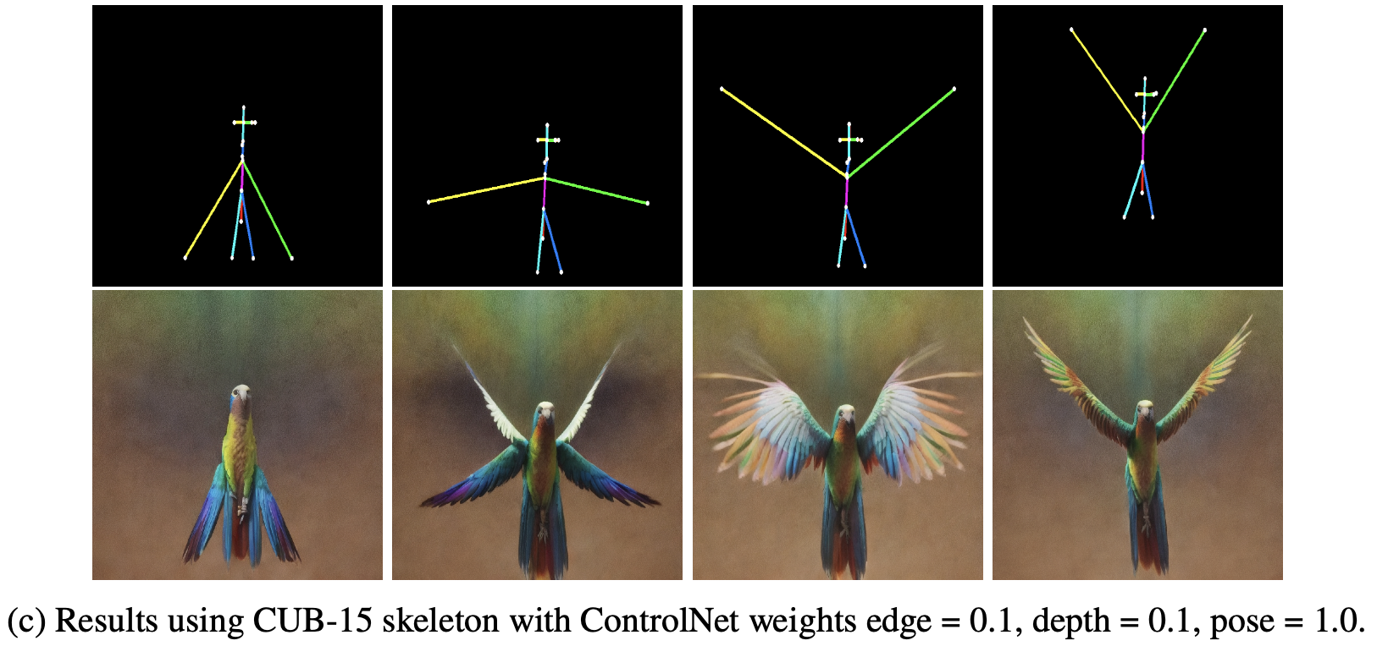
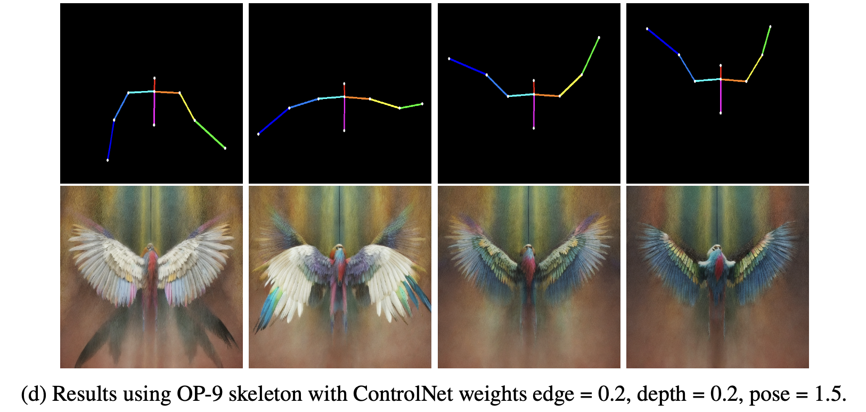
Results – Video Rendering 2
OP-9 skeletons: more aligned with human priors but less avian-specific; required stronger control → less flexibility, occasional artefacts.
Takeaway: CUB-15 offers better balance between fidelity and controllability.

Slide 14
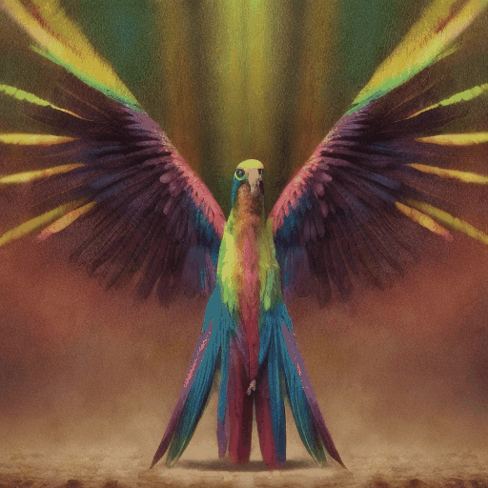
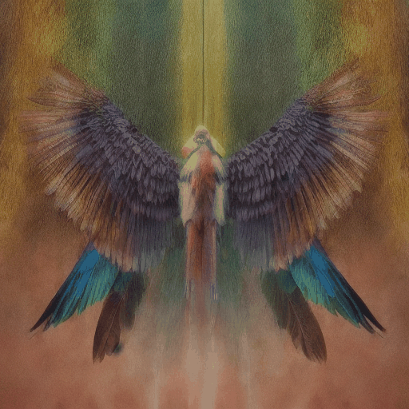
Results – Video Rendering 2
CUB-15
edge=0.1, depth =0.1, pose =1.0
OP-9
edge=0.2, depth =0.2, pose =1.5

Slide 15
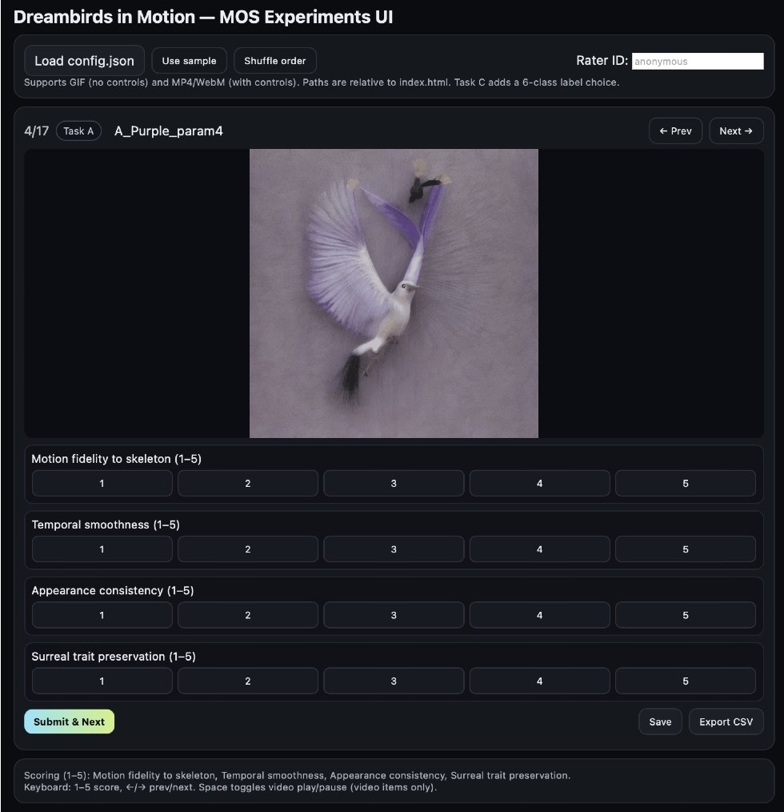
Results – MOS Evaluation
18 raters, 4 tasks:
Parameter sensitivity:
best at Edge=0.1, Depth=0.2, Pose=1.2.
Input robustness:
stable across species/backgrounds.
Label distinguishability:
gliding/landing/hovering recognised above chance.
Skeleton comparison:
CUB-15 consistently outperformed OP-9.
Overall: MOS confirms controllability & style preservation.

Slide 16
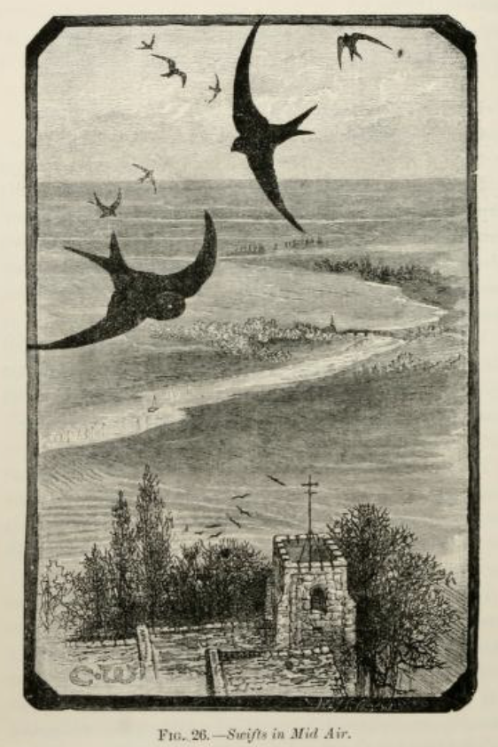
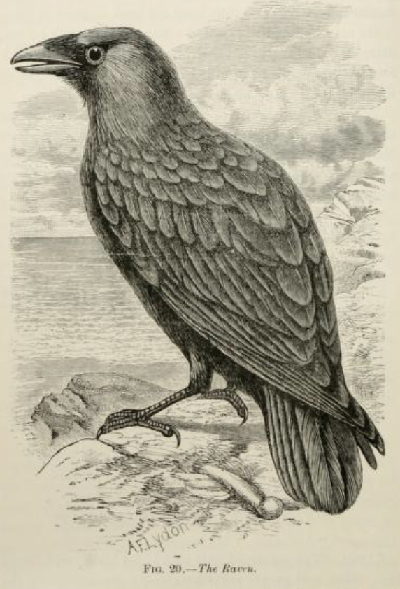
Discussion
Strengths:
Controllable skeletons.
Smooth motions.
Surreal style retention.
Limitations:
Dataset coverage (few extended wing poses).
2D skeleton → orientation/depth ambiguity.
Manual ControlNet tuning required.
Implication:
Bird-specific skeletons & automated balancing are key.

Slide 17
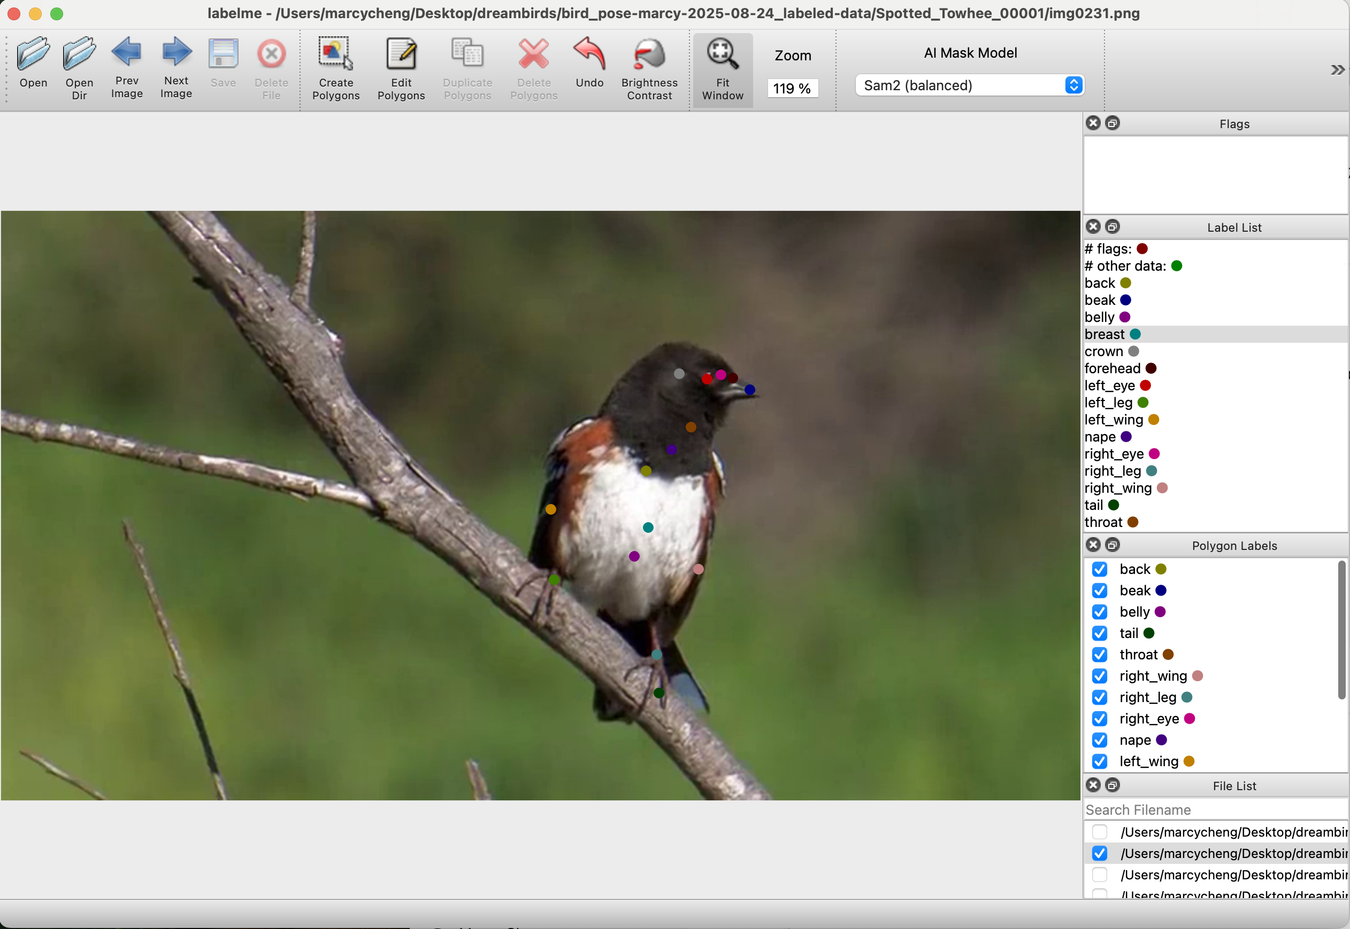
Conclusion & Future Work
Contributions:
Introduced CUB-15 skeleton for birds.
Trained MDM with action labels + first-frame anchoring.
Integrated AnimateDiff + multi-ControlNet for controllable video synthesis.
Future directions:
Bird-specific video datasets.
3D skeleton lifting & temporal transformers.
Automated ControlNet weight tuning.
DeepLabCut

Slide 18
Thank you！

